Slide 1
SPAM DETECTION

Slide 2
Motivation
It is estimated that around 68% (predicted to increase even more) of all SMSs sent to Indian mobile subscribers are spam. The reason for such a vast number is that spammers have become more sophisticated and creative with their ideas to get their messages into people's inboxes.
The upsurge in the number of unwanted and virus-infected SMS/emails called spam has created an intense need to develop a robust and dependable program.
Without a spam detector, an email system is highly vulnerable since its network wouldn’t have any kind of protection against the many possible risks such as viruses, phishing attacks, compromised web links and other malicious content.
Spam filters/detectors help in protecting servers from getting overloaded with unnecessary messages and thus give an additional layer of protection to the users.
Finally, a spam detector classifies every message into two types: spam and ham(or good mail).
This classification helps in creating a user-friendly environment free of unwanted messages, thereby saving a lot of time and hassle.

Slide 3
Literature Review

Slide 4
Traditional and context-specific spam detection
(by Kawintiranon, Singh, Budak (2022)
Context-specific spam - It is any post that is undesirable given the context/theme of the discussion. This includes context-irrelevant posts like irrelevant advertising*.
Contribution of this paper?
Makes distinction between traditional spam and context-specific spam. What qualifies as spam varies across domains.
Different domains/themes of conversation on Twitter have different levels of spam, leading to different class balances in training data sets.
*Irrelevant advertising is advertising that is not related to the discussion domain.

Slide 5
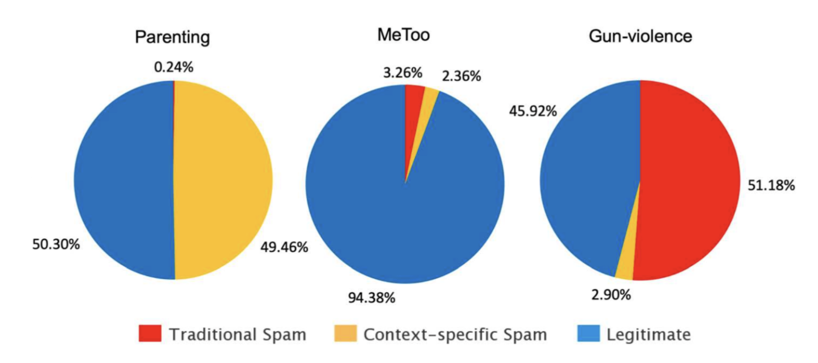
Figure: Need for cross-domain generalizability and transferability of spam detection models on Twitter.

Slide 6
Multiclass SMS Message Categorization
Past researches on SMS spam detection only classified SMS into two categories, spam and not spam. The binary classification of SMS spam prevents the user from seeing the spam messages that they do not really hate, e.g. an advertisement from their favorite product.
Dewi et al. (2017) propose multiclass classification of SMS into: regular, info, ads, and fraud.
They use content-based (top-N unigram) as well as non-content based features.
The result shows that the best accuracy is achieved by logistic regression that is 97.5 % accuracy with configuration of normalization preprocess and 4096 top-N unigram features.

Slide 7
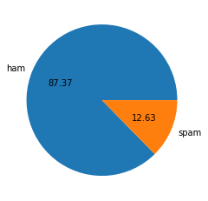
Dataset: Description
We have used the SMS Spam Collection Dataset from the UCI Machine Learning Repository available at https://www.kaggle.com/datasets/uciml/sms-spam-collection-dataset. The SMS Spam Collection is a public set of SMS labeled messages that have been collected for mobile phone spam research.
It contains one set of SMS messages in English of 5,574 messages, tagged as being ham (legitimate) or spam, which are the two types of classification of our dataset.
Out of these, 87% messages are labelled as ham and around 13% as spam. This shows that data is highly imbalanced

Slide 8
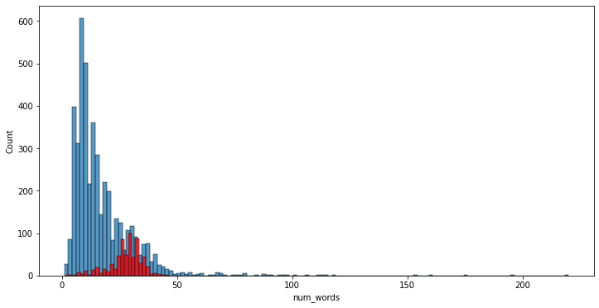
Dataset Description
Higher number of words shows a higher probability of it being a spam message

Slide 9
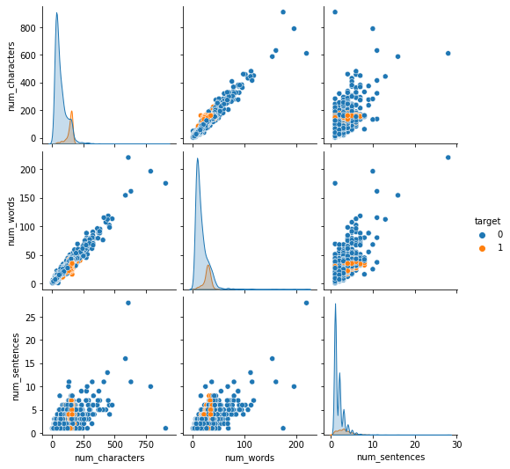
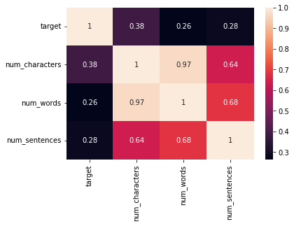
Dataset: Description

Slide 10
Dataset: Cleaning and Preprocessing
For data cleaning, we:
Dropped columns having majority null values
Changed columns names from v1 → target, v2→ text
Replaced string values in the ‘target’ column with integer values: ham as 0 and spam as 1.
Removed duplicates
We divided the preprocessing into the following steps (in order):
Lower case
Tokenization (breaking into words)
Removing special characters
Removing stop words (have insignificant contribution in the meaning of the sentence) and punctuation
Stemming (reducing a word to its word stem)
This helped us filter out the relevant and significant words in a sms that will be useful for our model making and its analysis.

Slide 11
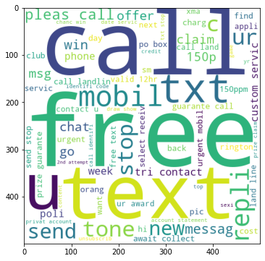
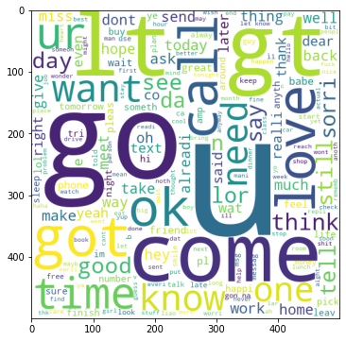
Dataset Description - PREPROCESSING ANALYSIS
In order to illustrate the most common words used in spam and ham messages, we used WordCloud.
For Spam
For Ham

Slide 12
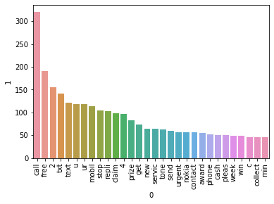
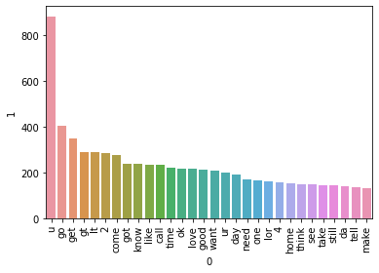
Dataset Description - PREPROCESSING ANALYSIS
We also applied a frequency counter of the top 30 most common words in spam and ham messages:
For spam
For ham

Slide 13


Methodology
1. Vectorization - For converting input data from text into vectors of real numbers which is the format that ML models support. There are several vectorization methods:
Bag-of-Words/Count Vector: We don’t use Bag-of-Words since the vector doesn’t contain any meaningful information, other than word frequency.
TF-IDF: TF-IDF or Term Frequency-Inverse Document Frequency, is a numerical statistic that’s intended to reflect how important a word is to a document. Sequential/contextual information is still lost.

Slide 14
Methodology
Word2Vec and GloVe! - A group of related models used to produce word embeddings.
Uses a novel idea of dense distributed representation of each word. Now ‘context’ is embedded into each word.
Word2Vec will be used later together with LSTM

Slide 15
Methodology
2. Model Details
We have split the above dataset into a training and testing set using a 70:30 stratified split. After that, we trained the data on 3 fold cross-validation.
After dividing the dataset, we chose some supervised learning models to train and test on the dataset.
The models used and the preliminary results without hyperparameter tuning for each model is shown on the next slide.

Slide 16
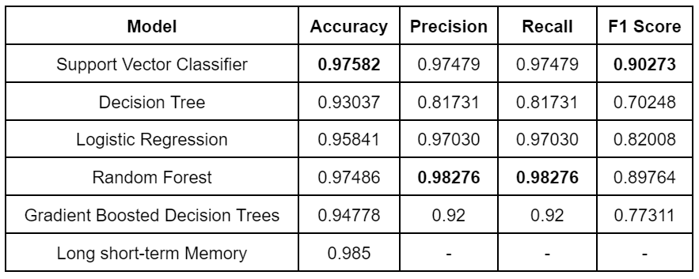
Results and Conclusion

Slide 17
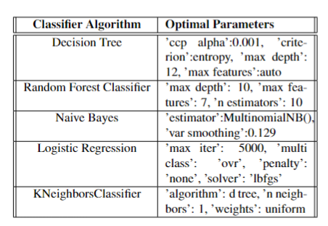
GRID SEARCH
In order to find the most accurate predictions for our model, we used various methods, one of them being the Grid-Search which is used to find the optimal hyperparameters of a model.

Slide 18
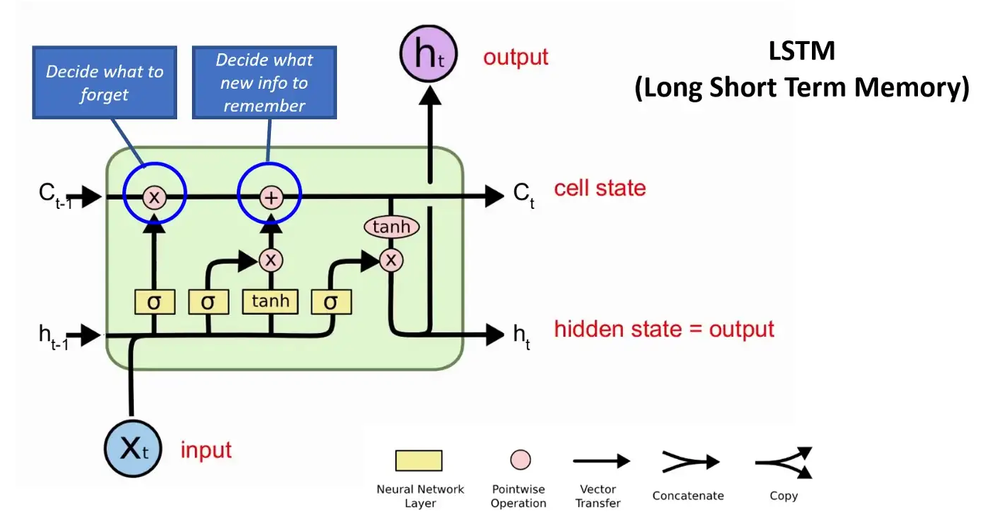
LSTM
For Neural Network architecture, we decided to use LSTM. Long Short Term Memory (LSTM) is a variant of the Recursive Neural Network (RNN), which is used for sequential data processing tasks.

Slide 19
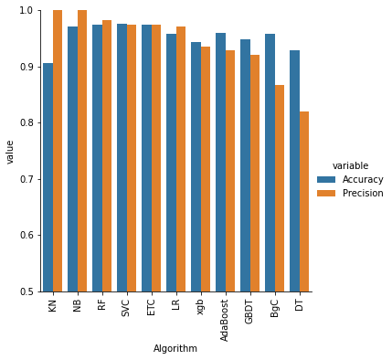
Results and Conclusion

Slide 20
Results and Conclusion
Through this mid sem report it is shown that preprocessing can play an especially extensive role in getting the data into model inputtable form. Machine learning model techniques, and tools used play a vital role in classification scores analysis. The machine learning model techniques used are Multinomial Naive Bayes, Logistic regression, Gaussian Naive Bayes, Decision trees, Random forests, etc. with 3-fold cross validation. Random Forests and Multinomial Naive Bayes give the best accuracies.
Our methodology not just includes data cleaning and normalization but also incorporates various Natural Language Processing techniques to remove extraneous parts from the text such that only the core, semantically and sequentially important tokens remain. We have achieved almost perfect accuracy and precision score metrics of around 95-98% in 3 out of 5 models, which reiterates that the feature engineering performed by us has performed well.

Slide 21
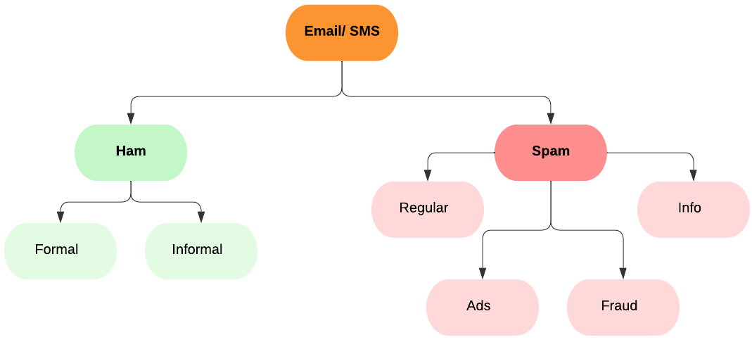
Future Work
This work has a high potential for further research. The spam classification done as of now does binary ham-spam classification. However, it can further be extended:

Slide 22
Contributions
Hitesh Bhandari → Literature Survey, Dataset Preprocessing and visualization , Training models, Report Writing, Presentation preparation
Kushiluv Jangu → Introduction/ Abstract, Dataset visualization, Training models, Conclusion, Report Writing, Presentation preparation
Rohit Aggarwal → Literature Survey, Dataset Analysis, Conclusion, Report Writing, Presentation preparation
Samarth Raina → Introduction/ Abstract, Dataset Analysis, preprocessing & visualization, Results and Analysis, Report Writing, Presentation preparation, Future Work

